Slide 1

Literature
Review

Slide 2
What is a literature review?
Critical account of research that has been published in your field
Analysis of existing sources to build up a picture of current knowledge
Examination of how your research topic fits into this picture

Slide 3
Literature review
Difference between literature review and regular essay

Slide 4
Essay
Literature review
Focussed on answering a specific question/arguing a case
Gives overview of current thinking in your field/specific area and how this relates to the question you will address in your research
Will involve selecting evidence to support your ideas
Involves critical analysis of many sources to build a broad picture of the topic
Will have a conclusion which tries to answer the research question you have set
Will have a conclusion about current thinking in the field, how this fits in with your research question and how your research could further knowledge of the topic or challenge existing theories

Slide 5


Conducting research for your
Literature Review
Getting a general idea of the topic...
In your section of the library British Library catalogue

Slide 6

Conducting research for your
Literature Review
Strategic – Systematic - Focussed
Modifying and narrowing until you start to retrieve search results you have already seen

Slide 7

Conducting research for your
Literature Review
Tools

Slide 8
Name of database:
Search term used:
Possible useful source
Author:
Date:
Title:
Publisher:
Place Publication:
So what?
Ideas to follow up

Slide 9
 | Theme 1 | Theme 2 | Theme 3
Keywords Include: Synonyms Broader/Narrower terms Related terms Alternate spellings

Slide 10
What is the true legacy of the 2012 Olympics for local communities?
 | Olympics | Legacy | Local Communities
Keywords Include: Synonyms Broader/Narrower terms Related terms Alternate spellings | Olympic games | Legacy | London
 | London 2012 | Stakeholders | East End
 | Olympics | Change | Olympic boroughs
 | Beijing 2008 | Facilities | Hackney
 |  |  | Greenwich
 |  |  | Barking & Dagenham
 |  |  | Young people

Slide 11
Writing the Literature Review
Possible structures
  Chronological
  By subject
  By author

Slide 12
Writing the Literature Review
Structure
  Summarise a source or piece of research then include a quote to illustrate
  Analyse source – how does it relate to your own aims, how does it link to other research, does it contradict other research?
  Identify trends and shared viewpoints that emerge, how could these ideas be further tested?
  Use linking phrases to provide a joined-up picture of current thinking

Slide 13
POINT – EVIDENCE - EVALUATION
Studies in the field of diabetes treatment have touched on the issue of patient compliance. Investigations by Jones (1997) and Bloggs (2002) both uncovered the problem of the non-compliance of patients with their treatment regimes. However, this issue was not the main focus of either study and neither investigated the reasons for non-compliance.

Slide 14
Writing the Literature Review
Tools

Slide 15
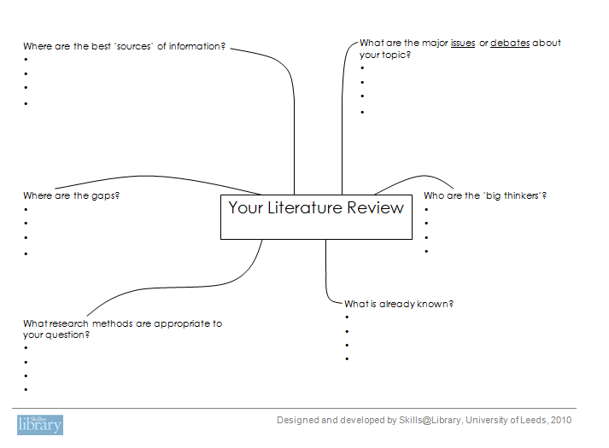

Slide 16
Synthesis Matrix
 | Source 1 | Source 2 | Source 3 | Source 4
Main idea A
Main Idea B
Main idea C

Slide 17
So What!?
Always bear in mind the importance of the research you are describing in terms of how this has advanced knowledge in the field, how it links with other studies and how it relates to your own research topic.
A literature review should not just present the research that has been conducted but also needs to address why it matters.
When reading or writing about sources, always remember to ask yourself…so what!?

